Slide 1
Software Engineering
Dr. Fatma ElSayed
Dr. Ahmed Yousry
Computer Science Department

Slide 2
Course Information
Contents
Introduction to Software Engineering
Software Processes
Requirements Engineering
System Modelling Part 1
System Modelling Part 2
System Modelling Part 3
Software Testing Part 1
Software Testing Part 2
System Architecture

Slide 3
Course Information
Contents
Introduction to Software Engineering
Software Processes
Requirements Engineering
System Modelling Part 1
System Modelling Part 2
System Modelling Part 3
Software Testing Part 1
Software Testing Part 2
System Architecture

Slide 4
Chapter 8: Software Testing Part 2

Slide 5


White Box Testing Techniques
Basis Path Testing
(1)
(2)
(3)
Construct the Control Flow Graph(CFG)
Compute the Cyclomatic Complexity Metric(CCM) of the Graph
Identify the Independent Paths
5

Slide 6
Independent Program Paths
An independent path is any path through the program that introduces at least one new set of processing statement or new condition.
When stated in terms of a flow graph, an independent path must move along at least one edge that has not been traversed before the path is defined.
If a path has one new node compared to all other linearly independent paths, then the path is also linearly independent.
Every statement in the program should be executed at least once and every condition will have been executed on its true and false.

Slide 7
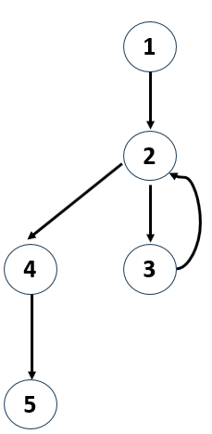
Cyclomatic Complexity
Cyclomatic Complexity
2
Basis set of independent paths
Path 1: 1-2-4-5
Path 2: 1-2-3-2-4-5
Each new path introduces a new edge.

Slide 8
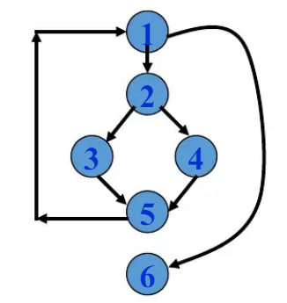
Cyclomatic Complexity
Cyclomatic Complexity
3
Basis set of independent paths
Path 1: 1-6
Path 2: 1-2-3-5-1-6
Path 3: 1-2-4-5-1-6

Slide 9
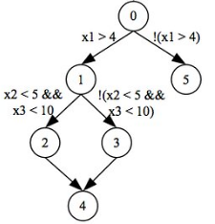
Cyclomatic Complexity
Cyclomatic Complexity
3
Basis set of independent paths
Path 1: 0-5
Path 2: 0-1-2-4
Path 3: 0-1-3-4

Slide 10
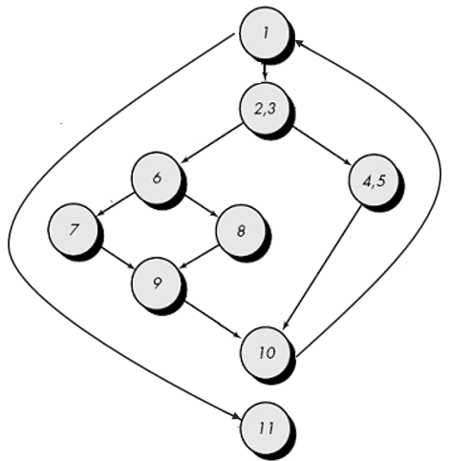
Independent Program Paths
Cyclomatic Complexity
4
Basis set of independent paths
Path 1: 1-11
Path 2: 1-2-3-4-5-10-1-11
Path 3: 1-2-3-6-8-9-10-1-11
Path 4: 1-2-3-6-7-9-10-1-11
What about this path?
1-2-3-4-5-10-1-2-3-6-8-9-10-1-11
Path is not independent

Slide 11
White Box Testing Techniques
Basis Path Testing
(1)
(2)
(3)
(4)
Construct the Control Flow Graph(CFG)
Compute the Cyclomatic Complexity Metric(CCM) of the Graph
Identify the Independent Paths
Design Test cases from Independent Paths
11

Slide 12
Deriving Test Cases
Path 1: 1-2-4-5
Path 2: 1-2-3-2-4-5
void fun(){
x = 0
while (x < 10){
print(x)
x += 1
}
y = x + 3
}
Case # | Path | Input | Expected outcomes
1 | 1-2-3-2-4-5 | x = 0 | Print(0), Y=13
2 | 1-2-4-5 | x=10 | Y=13
Test cases should be designed to force execution of the independent paths (basis set).

Slide 13
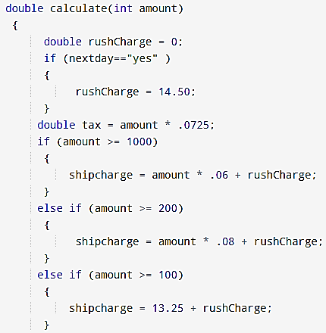
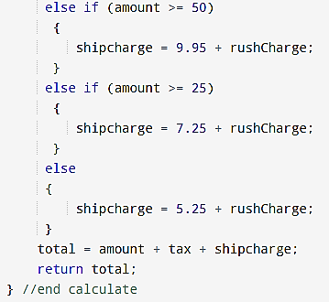
2
1

Slide 14
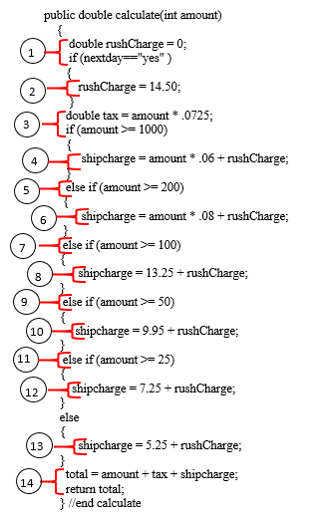
1
2
3
4
5
6
Cyclomatic complexity is:
V(G) = 7 Regions
V(G) = E-N+2 =
19-14+2 = 7
V(G) = P+1 =
6+1 = 7
8
7
10
9
12
11
13
14

Slide 15
1
nextday=yes
nextday=no
2
3
amount>1000
4
Basis set of independent paths:
1-2-3-4-14
1-2-3-5-6-14
1-2-3-5-7-8-14
1-2-3-5-7-9-10-14
1-2-3-5-7-9-11-12-14
1-2-3-5-7-9-11-13-14
1-3-4-14
amount<1000
amount>=200
6
5
amount<200
amount>=100
8
7
10
amount<100
amount>=50
9
amount<50
12
amount>=25
Note:
This basis set is not unique.
There are several different basis sets for the given CFG.
You may have derived a different basis set.
11
amount<25
13
14

Slide 16
Deriving Test Cases
Test cases should be designed to force execution of the independent paths (basis set).
Case # | Path | Input | Expected outcomes
1 | 1-2-3-4-14 | yes, amount = 1500 | 1713.25
2 | 1-2-3-5-6-14 | yes, amount = 300 | 360.25
3 | 1-2-3-5-7-8-14 | yes, amount = 120 | 156.45
4 | 1-2-3-5-7-9-10-14 | yes, amount = 90 | 120.98
5 | 1-2-3-5-7-9-11-12-14 | yes, amount = 40 | 64.65
6 | 1-2-3-5-7-9-11-13-14 | yes, amount = 10 | 30.47
7 | 1-3-4-14 | no, amount = 1300 | 1472.25

Slide 17
Testing Stages
Development testing
Release testing
User testing
Levels
Unit testing
Integration testing
System testing

Slide 18
Integration Testing
When distinct modules are combined, we need to verify they interact correctly. We can approach this from two perspectives:
Black-Box
White-Box
Focus: Validating interfaces and external behavior.
No need to know internal code
The user view: We only care that specific Inputs produce the Expected Outputs.
Focus: How modules connect internally
Tests data flow, and code-level interactions.
The developer view: Examine code to ensure that modules communicate correctly and use the right commands and data formats.

Slide 19
Testing Stages
Development testing
Release testing
User testing
Levels
Unit testing
Integration testing
System testing

Slide 20
System Testing
System testing checks that components are compatible, interact correctly and transfer the right data at the right time across their interfaces.
It is where all of the components in a system are integrated and the system is tested as a whole.
Software is incorporated with other system elements (e.g., hardware, people, information), and a series of system integration and validation tests are conducted.

Slide 21
Testing Stages
Development testing
Release testing
User testing
Levels
Unit testing
Integration testing
System testing

Slide 22
Release Testing
There are two important distinctions between release testing and system testing during the development process:
A separate team that has not been involved in the system development should be responsible for release testing.
System testing by the development team should focus on discovering bugs in the system (defect testing). The objective of release testing is to check that the system meets its requirements and is good enough for external use (validation testing).

Slide 23
Testing Stages
Development testing
Release testing
User testing
Levels
Types
Unit testing
Scenario Testing
Integration testing
Recovery Testing
System testing
Security Testing
Notes:
Scenario Testing: Uses real-life end-to-end scenarios to make sure the system works correctly in practical use cases
Recovery Testing: Checks how well the system recovers after a failure
Security Testing: Ensures the system is protected against threats, unauthorized access, data leaks, and attacks.

Slide 24
Testing Stages
Development testing
Release testing
User testing
Levels
Types
Types
Unit testing
Scenario Testing
Alpha Testing
Integration testing
Recovery Testing
Beta Testing
System testing
Security Testing

Slide 25
Alpha Testing
It is conducted at the developer's site by a customer.
It is done under supervision of the developer.
The software is used in a natural setting with the developer "looking over the shoulder" of the user and recording errors and usage problems

Slide 26
Beta Testing
It is conducted at customer sites by the end-user of the software.
Beta test is a "live" application of the software in an environment that cannot be controlled by the developer.
The customer records all problems that are encountered during beta testing and reports these to the developer at regular intervals.
As a result of problems reported during beta tests, software engineers make modifications and then prepare for release of the software product to the entire customer base.

Slide 27
Thank You

